Slide 1


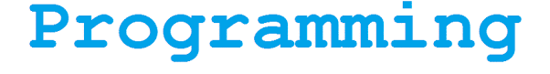

Network Routing TableUsing Graphs
Akash Murthy [PES2201800266]
Reshma P Roy [PES2201800039]
Dept. Of Science & Humanities

Slide 2
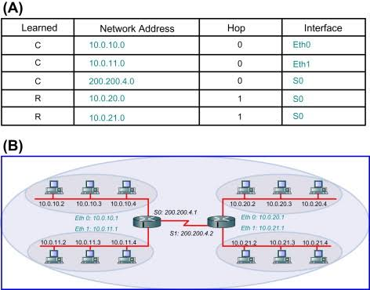
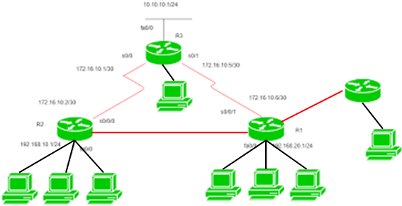
Problem definition
Program to handle routing table (network related) using the relevant data structures
A routing table contains necessary information to forward data packets through a network of routers along the best path from origin to destination.

Slide 3
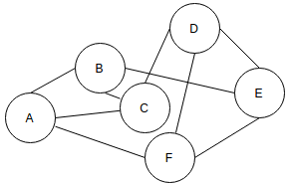
Data Structures Used
NULL
NULL
Graphs
Router Nodes (A, B, C, D, E & F)
Linked List
Devices (Blue Boxes)
NULL
NULL
NULL
NULL
NULL

Slide 4
Approach to problem solving
NULL
NULL
Devices
IP address
Sub net masks
Interface
Usage of Dijkstra's Algorithm
to find the shortest path between two clients or routers
Usage of Depth First Search Algorithm
to find devices
ip_addr
submask
interface
NULL
NULL
NULL
NULL
NULL

Slide 5
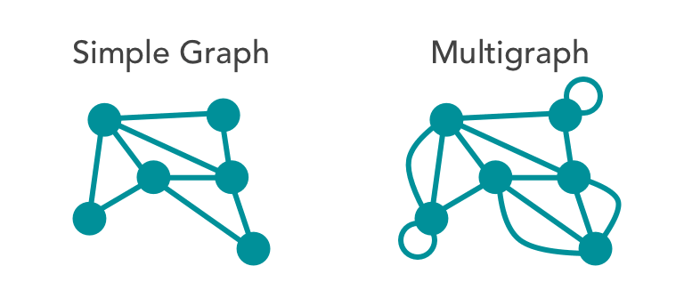
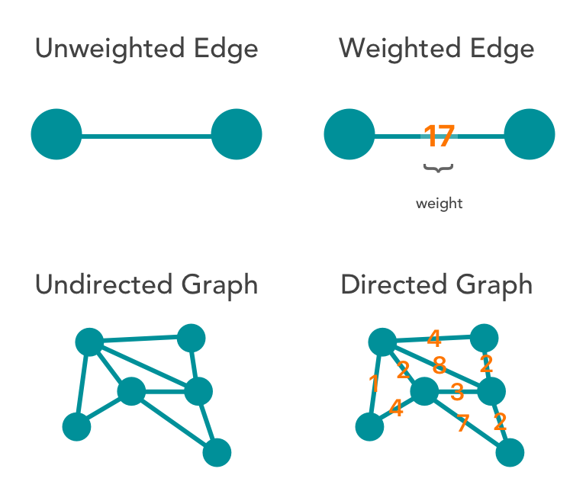
Assumptions made
Weights of all edges are constant
Graph is undirected and simple
No self referential edges
Max of 50 devices per router node
All routers are connected to Source Node – 0
Single Connected Component

Slide 6
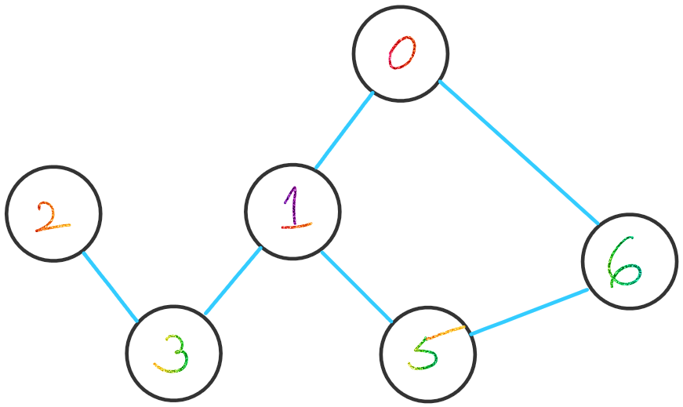
Demonstration

Slide 7
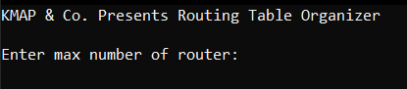
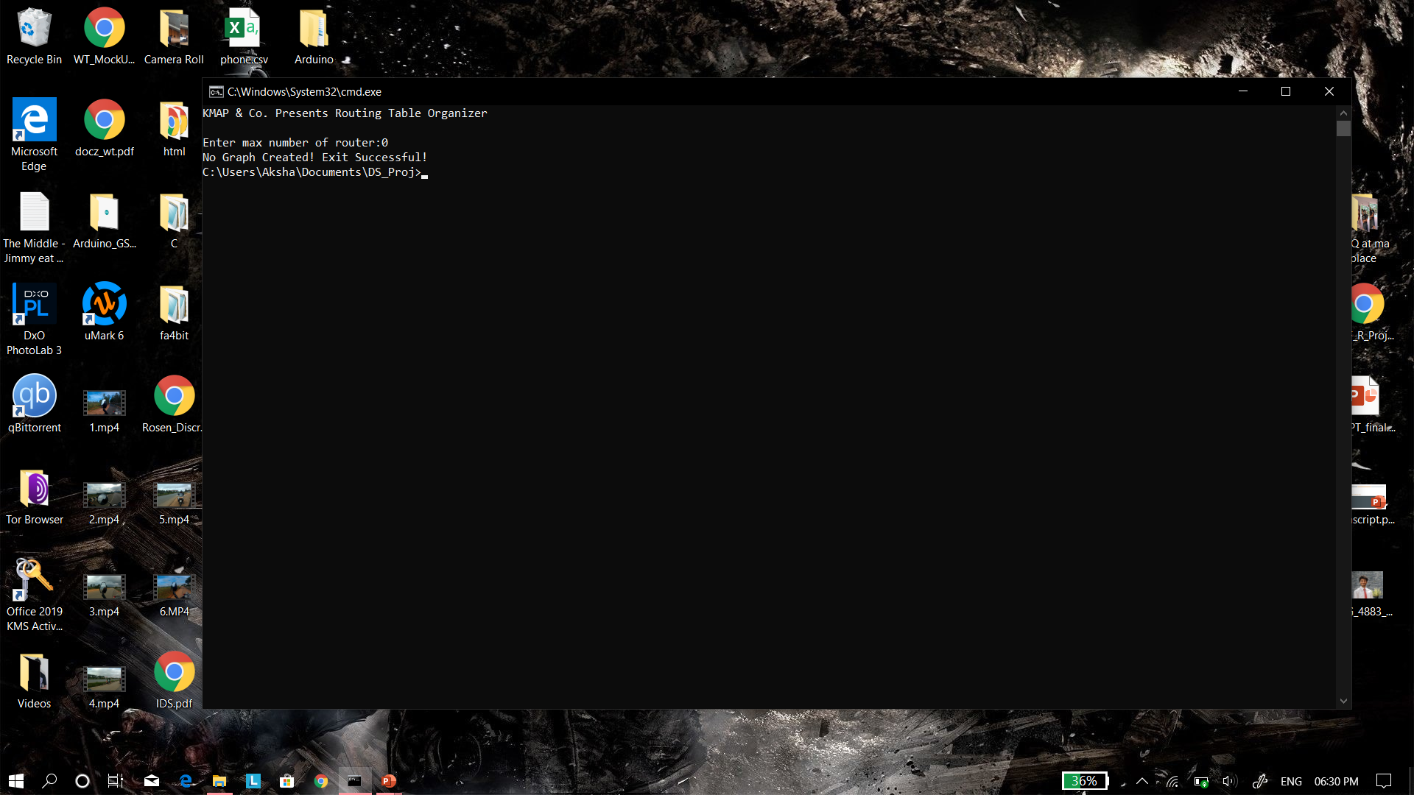
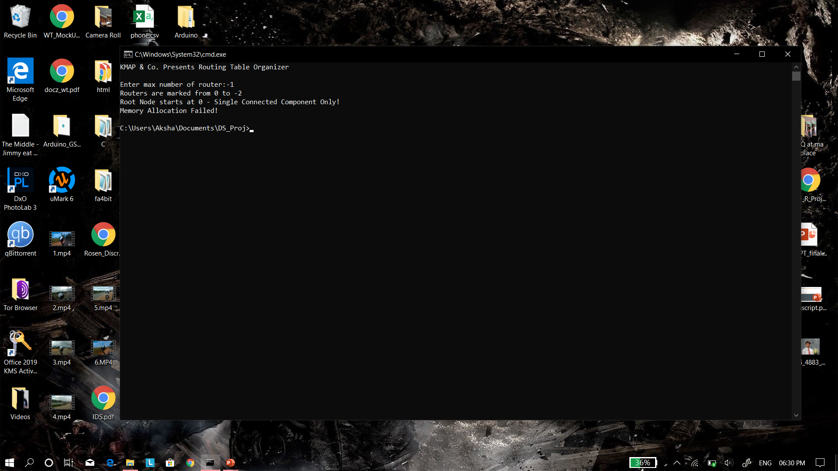

Slide 8
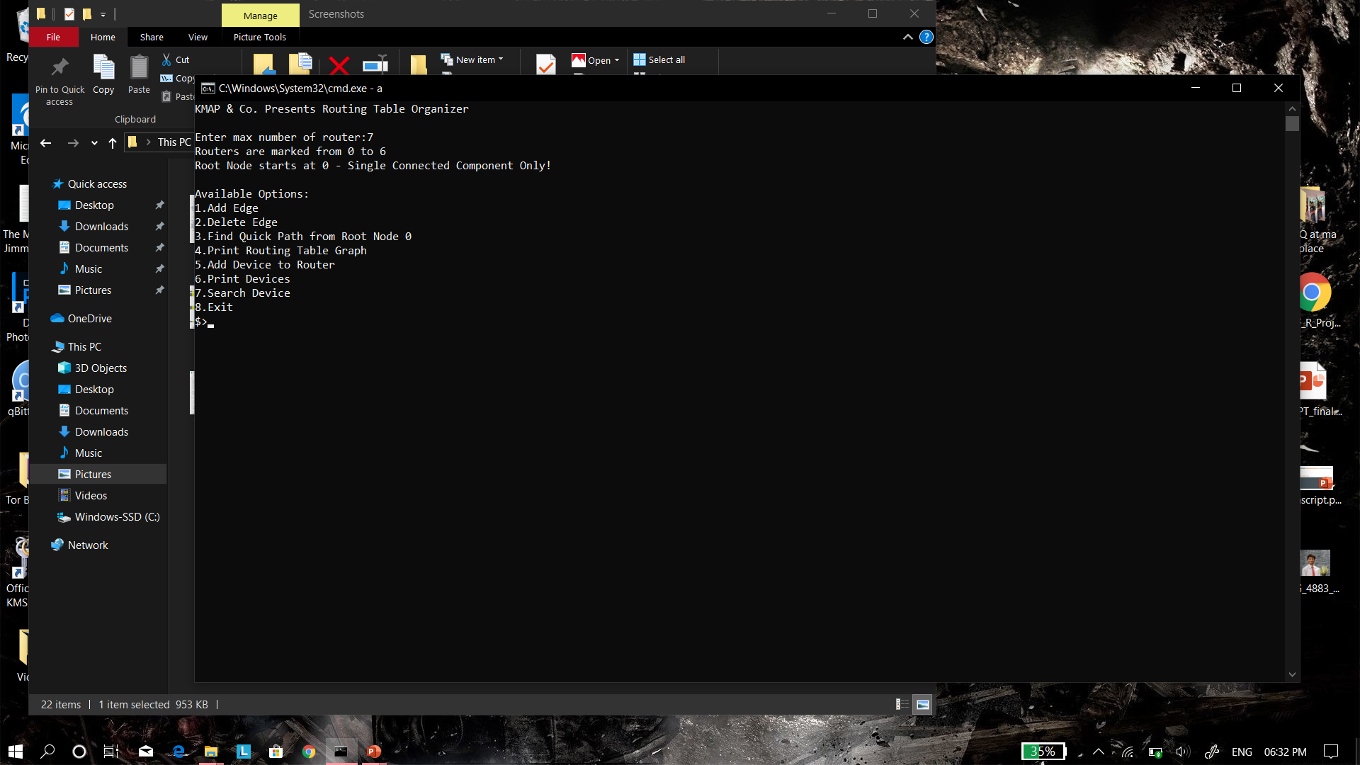
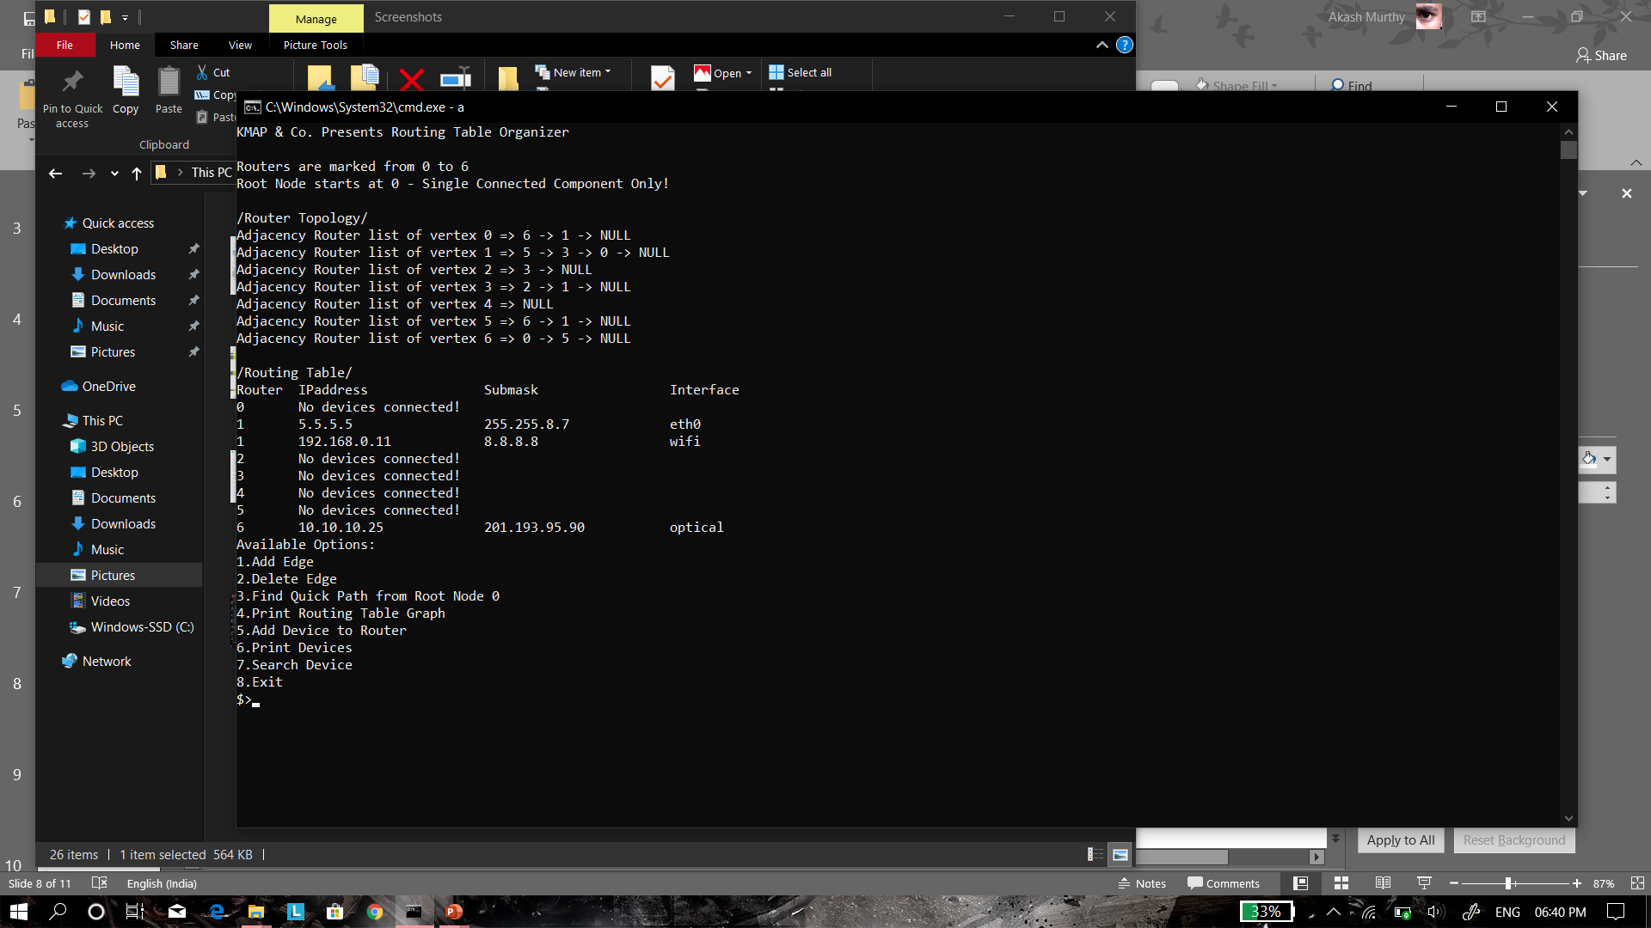
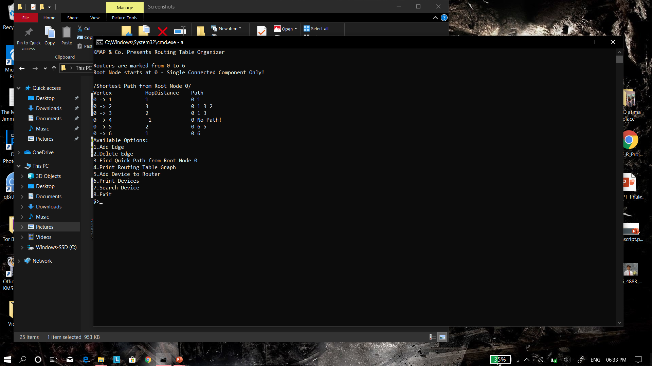

Slide 9

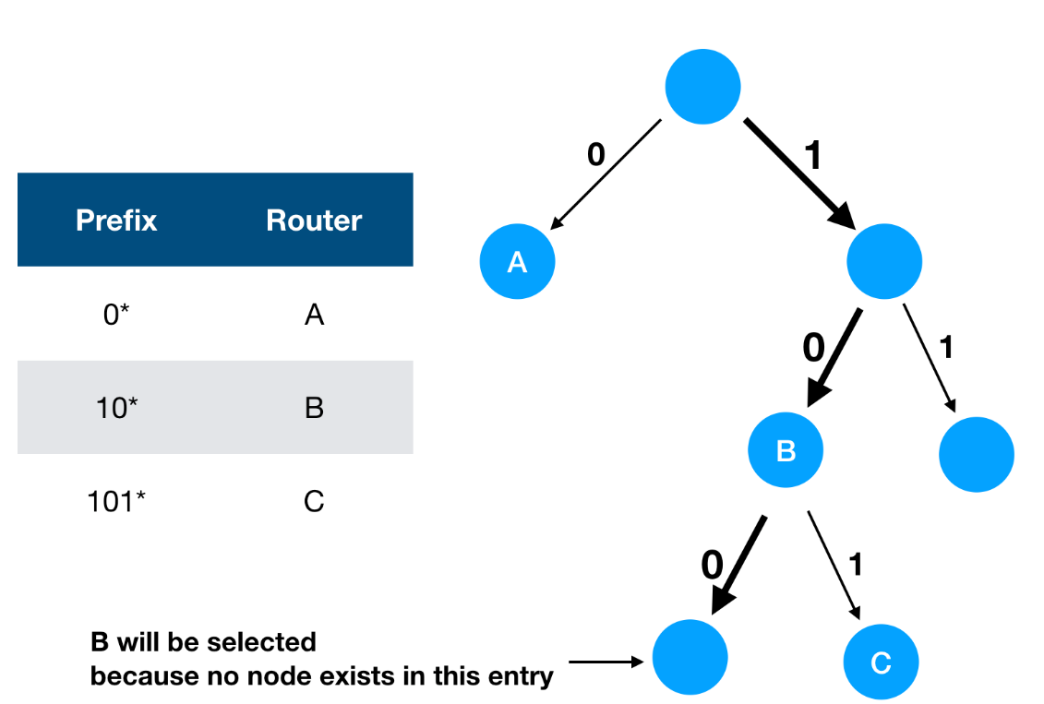
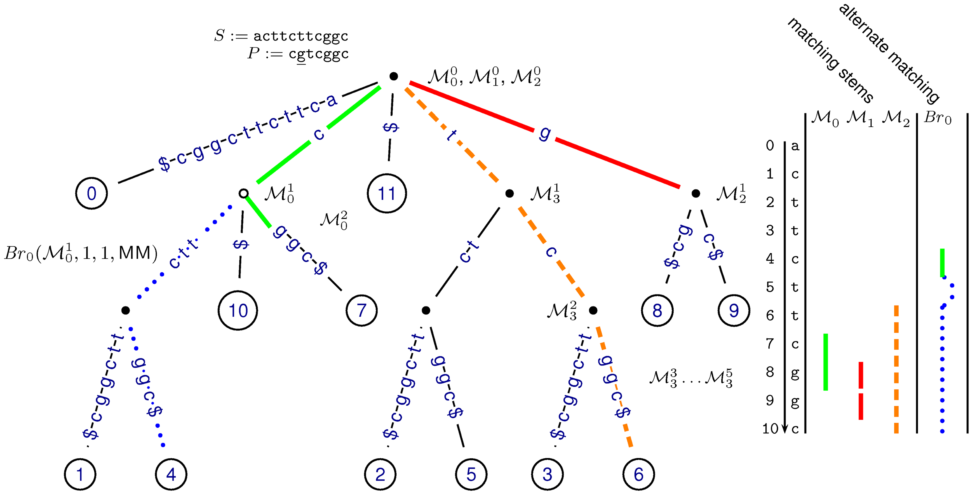
Limitations/Constraints
Two or more Routers need to be initialised to add an edge
Routers need be connected to add devices
Longest prefix match for IP Address is not possible with current data structure
Required data structure is Trie

Slide 10
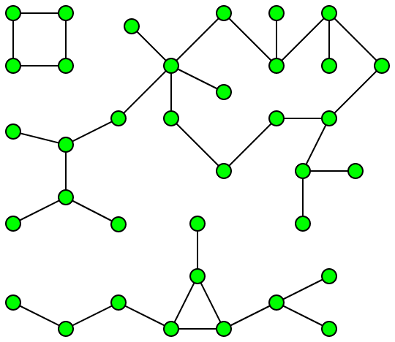
Known defects
Program does not work with multiple component graphs
Error handling is in place to check for the same
Adding new edges with pre-existing edges causes devices to be reset with node being connected
Hence Routers design needs to be added first then devices

Slide 11
Any Questions?

Slide 12

Thank You for listening

